Slide 1


DAY4
LECTURE NO 4
PYTHON PROGRAMMING
Learn AI
Eraj Amir

Slide 2


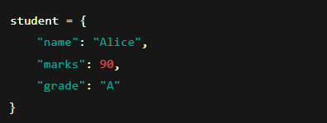

Dictionaries in Python
A dictionary is a collection that stores data in key-value pairs.
🔑 Key Features:
Unordered: Items don’t have a fixed order.
Mutable: You can change them.
No duplicate keys: Each key must be unique.
🧠 Basic Syntax:
"name", "marks", and "grade" are keys.
"Alice", 90, and "A" are their values.

Slide 3


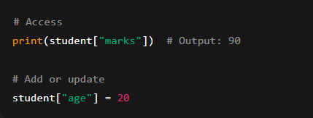
Accessing & Adding Values:

Slide 4

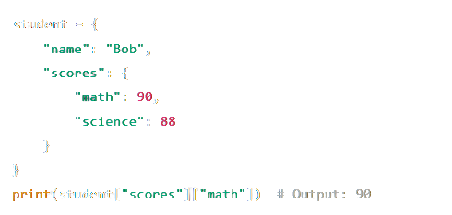
Nested Dictionaries
A nested dictionary means a dictionary inside another dictionary.
Example:

Slide 5

Dictionary Methods
myDict.keys()
myDict.values()
Returns all keys
Returns all values
myDict.items()
myDict.update(newDict)
myDict.get("key")
Returns all (key, value) pairs as tuples
Returns value of the key (returns None if key doesn’t exist)
Adds another dictionary’s data

Slide 6
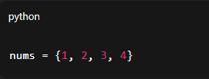
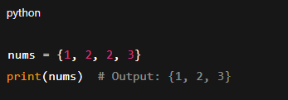
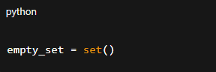
Sets in Python
A set is a collection of unique, unordered, and immutable elements.
EXAMPLE:
Repeated items are removed automatically:
Creating an Empty Set:
Note: {} creates an empty dictionary, not a set.

Slide 7





SET METHODS
set.add(el)
set.remove(el)
Adds element el
Removes element el, errors if not found
set.clear()
set.pop()
Empties the entire set
Removes a random element
set.union(set2)
set.intersection(set2)
Combines all elements from both sets
Only keeps common elements

Slide 8



Practice Questions
2
1
3
Medium
Easy
Hard
Concept Application
Basic Understanding
Concept Mastery

Slide 9
Easy Qs
Create a dictionary to store the name and marks of a student.
Add a new key "age" with value 20 to an existing dictionary.
Retrieve and print the value of key "marks" from the dictionary: {"name": "Ali", "marks": 85}.
Create a set with values: 1, 2, 2, 3, 3, 3. Print the set.
Create an empty set and add the elements 10, 20, and 30 using add().
Use set.pop() on a set of 5 elements and print the result.
Use dict.get() to safely retrieve a value for a key that may not exist.
Print all keys from a dictionary using .keys().
Create a dictionary with three keys: "A", "B", "C" and assign any values.
Create a set, remove an element using remove() and print the updated set.

Slide 10
Medium Qs
Create a dictionary with subject names as keys and user input marks as values.
Merge two dictionaries using update() and print the result.
Given a list: ["python", "java", "C++", "python"], find the number of unique subjects using a set.
Use a nested dictionary to store student name and marks in math and science. Then print the math marks.
Write code to store three word-meaning pairs in a dictionary and print the dictionary.
Create a set with different types: 9, "9", and 9.0. Print the set and explain the result.
Write code to delete a key from a dictionary.
Use .items() to loop over all key-value pairs in a dictionary and print them.
Find and print the intersection of two sets.
Take 3 subject names and marks from the user and store them in an initially empty dictionary.

Slide 11
Hard Qs
Write a function that takes a list and returns a set of only unique elements.
Create a dictionary and remove all key-value pairs where the value is less than 50.
Create a nested dictionary where each student has name, age, and a nested dictionary of subjects and scores.
Take 5 word-meaning pairs from user input and store them in a dictionary.
Write a program to count how many times each subject appears in a list using a dictionary.
Write code to reverse a dictionary: make keys become values and values become keys.
Write a function that receives two sets and returns a set of elements that are in either but not both (symmetric difference).
Store both 9 and 9.0 as separate values in a set using any trick with built-in types.
Simulate classroom allocation: given a list of subjects with duplicates, calculate how many classrooms are needed (hint: use set).
Create a set, and use a loop to pop() all elements one by one, counting how many iterations it takes to empty the set.

Slide 12
Thank You
@LEARN AI

